Slide 1
Introduction to Boxes
The Basics

Slide 2
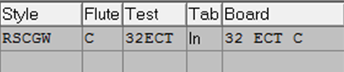
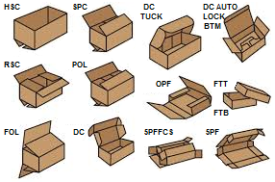
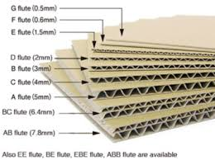
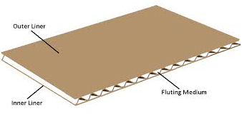
Overview of Terms KNOWLEDGE OF STYLE CODES AND DESCRIPTION IS ESSENTIAL!!!!
BOARD TEST
Each product is designed to meet standards based on its use. There are two types of tests, yet combinations are unlimited.
If your primary concern is crushed boxes and stacking problems, consider specifying in terms of ECT (Edge Crush Test).
If it’s containment strength and puncture resistance, consider specifying in terms of burst (“Mullen” Test).
STYLES
Styles include items from the most basic “Regular Slotted Container (RSC)” to more complicated custom-made items. Sometimes an item is a combination of two or more styles, or a die cut item when special tooling is required for processing.
Partitions, Pads, Scored sheets, Slit-Scored sheets, etc. all fall into the corrugated category of items processed through CBC.
Some items will not require conversion. Items that do not require conversion are commonly referred to as “ship-in-ship-out” or “purchased finished goods” and do not require an estimate file.
BOARD GRADE/FLUTE
I think of “Grade” in terms of ABCs, the structure of the wave shaped material that makes up the board is a “flute” grade. following are the main flutes used by CBC:
Single Wall – A, B, and C,
Double Wall – BC
Triple Wall – CAA (outsourced)

Slide 3
Dimensions
Specifying Container Dimensions
Specifying Sheet Sizes
Container dimensions are always inside dimensions and must be stated in the sequence of length, width, and depth. The first two of the dimensions specify the size of the opening with the greater being the length. The depth is the distance measured perpendicular to the length and width between the innermost surfaces of the container.
Even so-called “end opening” or “side opening” containers follow the same principles.
For example: to change a simple RSC, 15x10x5, to an end-opening style, simply specify the RSC 10x15x5. The side-opening style would be specified as RSC, 15x5x10. Following the principles, it is unnecessary to specify top, end, or side opening.
Since the end-opening and side-opening containers are usually stacked on their sides, it is common practice to reverse corrugation direction.
The proper specification for the previously discussed container is, RSC with reverse corrugation, 10x5x15
When specifying sheet size, the first dimension is always the width and is measured parallel to the corrugation direction. The length is always the second dimension and is measured perpendicular to the corrugation direction.

Slide 4
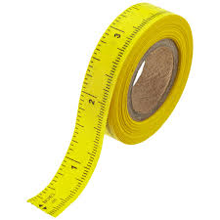
Measuring Inside Dimensions
Although measuring boxes is not normally the responsibility of the customer service, it is important to understand within the estimating function.
Open the box and lay out flat with the inside facing up. This may entail cutting tape, removing stitching or separating the glue joint from adjacent panel.
Carefully mark the center of each score. Make sure you have the center line and not a crease or wrinkle.
Measure from the inch mark on your ruler (never from the end) to the closest 1/16”. Write the result on the panel measured. Make sure to mentally deduct one(1) inch from your measurement to arrive at the gross panel size.
Deduct the scoring allowance from the gross panel measurement in order to arrive at the net inside size. (If you don’t know the scoring allowance, deduct one board thickness for each score * SEE NEXT PAGE).
Doe the same for the flaps. Be sure and check the combined flap measurement against the width.
Add the flaps plus the depth, net measurements, plus standard scoring allowances and check against the actual blank width.
Do the same for the length and width panels and check against the actual blank length.
You should check within plus or minus 1/16” on the width of the blank and plus or minus 1/8” on the length of the blank. Always remember that other plants may use slightly different allowances than we do. Never try to measure a box blank in set-up condition or from the outside.
If there is any discrepancy between panels, choose the #2 and #3 panels, the inside panels are probably the more accurate.
Always be suspicious of the competitor’s box. Make sure you are not copying somebody’s mistake.

Slide 5
Scoring Allowance Theory
Flutes
Fundamentals
The following chart delineates the general characteristics of each flute and flute combination:
Flute No. of Flutes Approx.
per Lineal Ft Height,
Inches
E 90 1/16
B 51 1/8
C 39 5/32
A 36 3/16
BC ---- 1/4
AB ---- 5/16
AC ---- 11/16
BCA ---- 7/16
CAA ---- 1/2
It can be readily observed that if a piece of corrugated board is scored or creased along two parallel lines, the distance between the facing panels bent up at 90º from the main panel is less than the original distance between the lines.
1. Measurement of this distance will establish the fact that the two facing panels, when parallel, are now closer together than the score-to-score dimension by a distance approximately equal to the thickness of the corrugated board (Fig. 1).
Fig 1. Scoring allowance, steps 1 and 2
2. At the same time the distance from the cut edge of the folded panel to the surface of the center panel will be measured at approximately one half a thickness less than the edge-to-edge score dimension (Fig. 1)

Slide 6
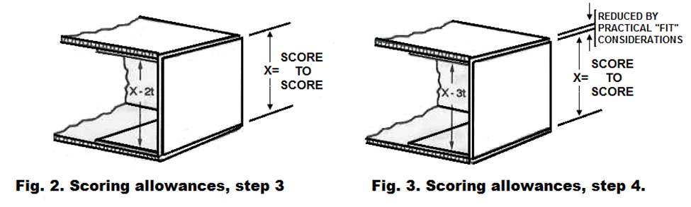
Regarding Flaps and “Fit” Considerations
The combination of these two phenomena results in a face to face dimension between the inner flaps which most closely approaches two board thicknesses less than the score dimension rather than the three which we might at first expect (Fig. 2).
If we were to offset the scores of the inner and outer flaps we could allow for each thickness plus the basic scoring allowance. Practical considerations again take over, however, it is generally found desirable to slightly reduce the offset in order to produce a tighter fitting and consequently better appearing exposed edge. (Fig. 3).
The second principle is that where a given structure interposes a thickness, or thicknesses, of board between the two parallel faces, the score-to-score dimensions must be increased accordingly.
If we apply these principles to the depth scoring of a regular slotted container, for example, we soon find that a practical consideration must be added. Both the inner and outer flaps are folded on the same score line. Because of the flexibility of corrugated board, the inner flaps tend to break inwardly from their normal position and the outer flaps to fold somewhat outwardly.

Slide 7
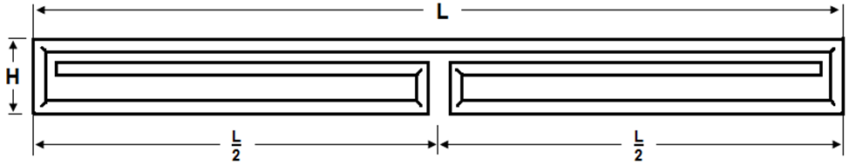
THEORY CONTINUED…
Flap scoring also follows these principles. We can consider the meeting flaps of a regular slotted container as merely a split width panel, with a total allowance of one thickness divided between the two halves. We can use the principle from Fig.1 to establish the same relationship. Generally however, the outward folding tendency of the outer flaps, referred to in discussion of the depth allowance, inclines those flaps to fold short of their theoretical dimension. We therefore temper the theory by adding enough dimension to insure correct butting of the flap edges.
The two theories are tempered by practical factors and ALWAYS affected by the necessity for compromises dictated by rounding figures to the closest sixteenth.
The outside of a corrugated form such as a simple “eight scored sheet”, follows from these principles.
If the size between two parallel faces is one thickness less than the score-to-score dimension, the outside must obviously be one thickness more.
To develop the structure, if we wish an outside size L, the inside size is two thicknesses less. The score-to-score dimension then becomes L-t as we add our scoring allowances (Fig. 4).
We add other scores to establish the second dimension H and our score-to-score dimension is H-t, following the same principle as before (Fig.5).
Fig. 4 Scoring allowance, step 5
Fig. 5 Scoring allowance, step 6

Slide 8
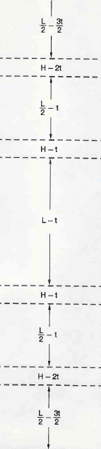
As we continue to develop the “eight scored sheet” cell, the half length panels are similarly scored 1/2L-t.
The center vertical panels have an outside size one thickness less than the outside panels, or H-t. We apply the same principle to derive a score-to-score dimension of H-2t.
The final panels have an inside size 1/2L-2t. Applying our earlier principle from Fig. 1, we add a half thickness allowance. The scoring thus becomes 1/2L-3/2t. The complete sheet is shown in Fig. 6.
Once the principles are understood it is easy to derive simple practical approaches to cell structures.
Scored Sheet
For example, we see immediately that the inner vertical panels are scored one thickness less than the H panels. It is probably self-evident that each succeeding corresponding panel is one thickness less than the preceding one.
In simple C-flute structures the thickness can be figured at 1/8 in. almost throughout. For example the “eight scored sheet” of the earlier example can be scored, for an outside size of 10 x 1-1/2, as follows:
4-3/4 x 1-1/4 x 4-7/8 x 1-3/8 x 9-7/8 x 1-3/8 x 4-7/8 x 1-1/4 x 4-3/4
Fig. 6. Example of a scored sheet (Fig. 5. folded view)

Slide 9
A DIFFERENT TWIST TO THE SCORED/FOLDED SHEET
In a more complex cell such as Fig. 7, the scoring of each panel is quickly derived by applying this additional concept. Panel D is scored one thickness less than B, E one less than C and so on. When we reach panel G, which immediately precedes the diagonal, we see that the sharp bend decreased the G panel, requiring added dimension.
Only as the structure becomes more complex, do we find that the approximation (from concept on previous page) results in the inner panels being too tight to allow proper formation. An additional sixteenth must be dropped from several panels to compensate.
Fig. 7 Example of a folded sheet.

Slide 10
CONVERSION CHART ROUND EVERYTHING TO THE NEAREST 1/16”
Fraction | Decimal | 16THs
1/16 | 0.0625 | .01
1/8 | 0.1250 | .02
3/16 | 0.1875 | .03
1/4 | 0.2500 | .04
5/16 | 0.3125 | .05
3/8 | 0.3750 | .06
7/16 | 0.4375 | .07
1/2 | 0.5000 | .08
9/16 | 0.5625 | .09
5/8 | 0.6250 | .10
11/16 | 0.6875 | .11
3/4 | 0.7500 | .12
13/16 | 0.8125 | .13
7/8 | 0.8750 | .14
15/16 | 0.9375 | .15
Dimensions are generally given in fraction or decimal format when quote requests are received for pricing, or afterwards when a customer places an order. However, when entering these dimensions into ASI, these figures must be converted to a unit of 16ths.
Occasionally, one might run across dimensions listed in 32nds. In this case round UP (never down) to the next measure of 16th. Measuring less could mean a product to small to accommodate customer’s product.

Slide 11
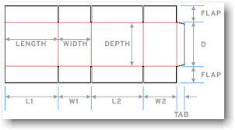
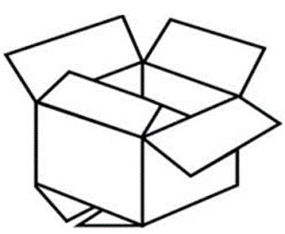
Box Basics
Normal Corrugation Direction
Combination – mixed style, for example; FOLB/RSCT means full overlap flaps on bottom, regular flaps on top.
Full Overlap – (FOL) Flaps are equal to width dimension so that they completely double coverage on the opening ends.
Gap Flap Container – (GAP) RSC flaps are shortened so that there is a gap or space between the two flaps when closed.
Tube – A tube is basically the body of the box without flaps, it is glued. The tube can also have a top/bottom flange(s) similar to a Gap Flap container, but flanges are normally given allowances for an outward bend, this normally affects the depth dimension, as the flaps are solid lengths as given. In ASI, these scores have been modified for an inward bend (majority customer preference).
Half Slotted Container – (HSC) Is an RSC with flaps on one end while the other end remains open.
Partial Overlap Container – (POL) RSC flaps extend past the center so that they overlap when flaps are closed. Overlap lengths vary.
Style requires L x W x D dimensions
Most Common
Regular Slotted Container – (RSC) Flaps are ~1/2 (Width) dimension. The flaps will meet in the center when box is closed. This is the most basic box, in which several other styles are derived from.

Slide 12
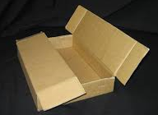

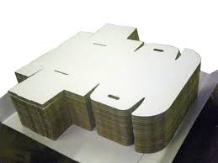
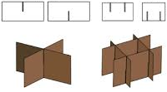
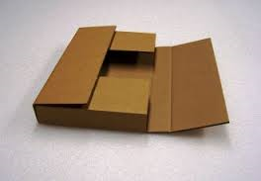
Flat Styles
Items Shipped Flat
Scored Sheet – a sheet of corrugated board that contains scores for bending. Liners are in the same category, but box dimensions are used to adjust scoring allowances that detract from the inside dimension so that the scored sheet snuggly fits inside the box without overlapping.
Scored/Slotted Sheet – Sheet that contains slit scores, i.e. fanfold items. Partitions also fall into this category.
Items that don’t fit into the basic “Box” category, sometimes require a combination of concepts for instance:
Die Cut – Items that are outside normal box styles and requires special tooling to produce. An item can be a full die cut (requires cutting die) or just require attachments, i.e. hand holes to a regular style box. A joined DC will require a glue process and will not ship flat.
5 Panel Folder (5PF) – scored and slotted sheet, style is to wrap merchandise and taped closed. Most common is the 5PFFCS (Five Panel Full Flap Center Seam). Corrugation is normally reversed for added container strength.
One Piece Folder (OPF) – A corrugated item that wraps around the custom’s product. Two end panels have a standard 2” tuck (unless otherwise stated), while the other side completes the top wrap.
Pad – A plain sheet of corrugated board customized to fit customers needs.

Slide 13

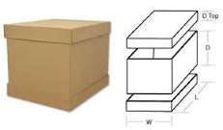
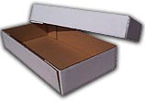
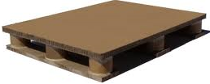
Set Items WHEN MORE THAN ONE PART MAKES UP AN ITEM.
Telescoping Tops and Bottoms
Telescoping Top/Bottom – Tray style boxes. The telescoping bottom is similar to a normal end/side slotted trays, but when used as set, the top style for the same size allows for a full snug fit over the bottom tray. This works as long as the flute combinations are the same. Fitting a C-flute top over a BC-Double wall bottom will require some manipulation.
Tray – Often referred to as a die cut tray, is merely an end or side slotted tray. It requires attachments, but not a full die. Same as the tray style Telescoping Bottom
Mixed Concepts
Sometimes, the customer wants an item that calls for several parts. For example a glued tube that fits into a tray style base and is topped off with a tray style lid.
Telescoping HSC Top/Bottom – Adjustable coverage concept is similar to the Telescoping Trays accept for style and variable depth coverage. The bottom is the same as a normal HSC, but the top is adjusted to fit over the outside dimensions using the same inside dimensions as the regular HSC. Once again, the flutes must match or manual manipulation will be necessary. There is a way to “cheat” and get ASI to do the math.
The customer may want pieces available separately or as a unit (set).
CBC does not make the corrugated pallets!
The corrugated pallet is an example of a unit that requires more than one part to create. Creating this in ASI is a challenge.

